Slide 1
EMPLOYEE MANAGEMENT SYSTEM
CHERUKU SIVANI
SBCS INDIA PVT.LTD

Slide 2
Abstract:
This projects includes a development presentation of an information system for managing the staff data within a small company or organization. The system as such as it has been developed is called Employee Management System.It allows you to easily add, view, edit, search and delete employee records. Additionally, the system provides advanced security measures to ensure sensitive data is kept safe.

Slide 3
Project Overview:
The Employee Record Management System project aims to provide a comprehensive solution for managing employee records in an organization. The system is designed to streamline the process of adding, viewing, editing, and deleting employee records, as well as searching for specific employees based on different criteria.
This project is important because it offers several benefits to organizations, including increased efficiency, improved accuracy of employee data, and enhanced security of sensitive information.
By using this system, organizations can save time and resources that would otherwise be spent on manual record-keeping processes.

Slide 4
Contents:
List the main functionalities of the system:
Add Employee
View Employee
Edit Password
Search Employee
Delete Employee
Exit

Slide 5
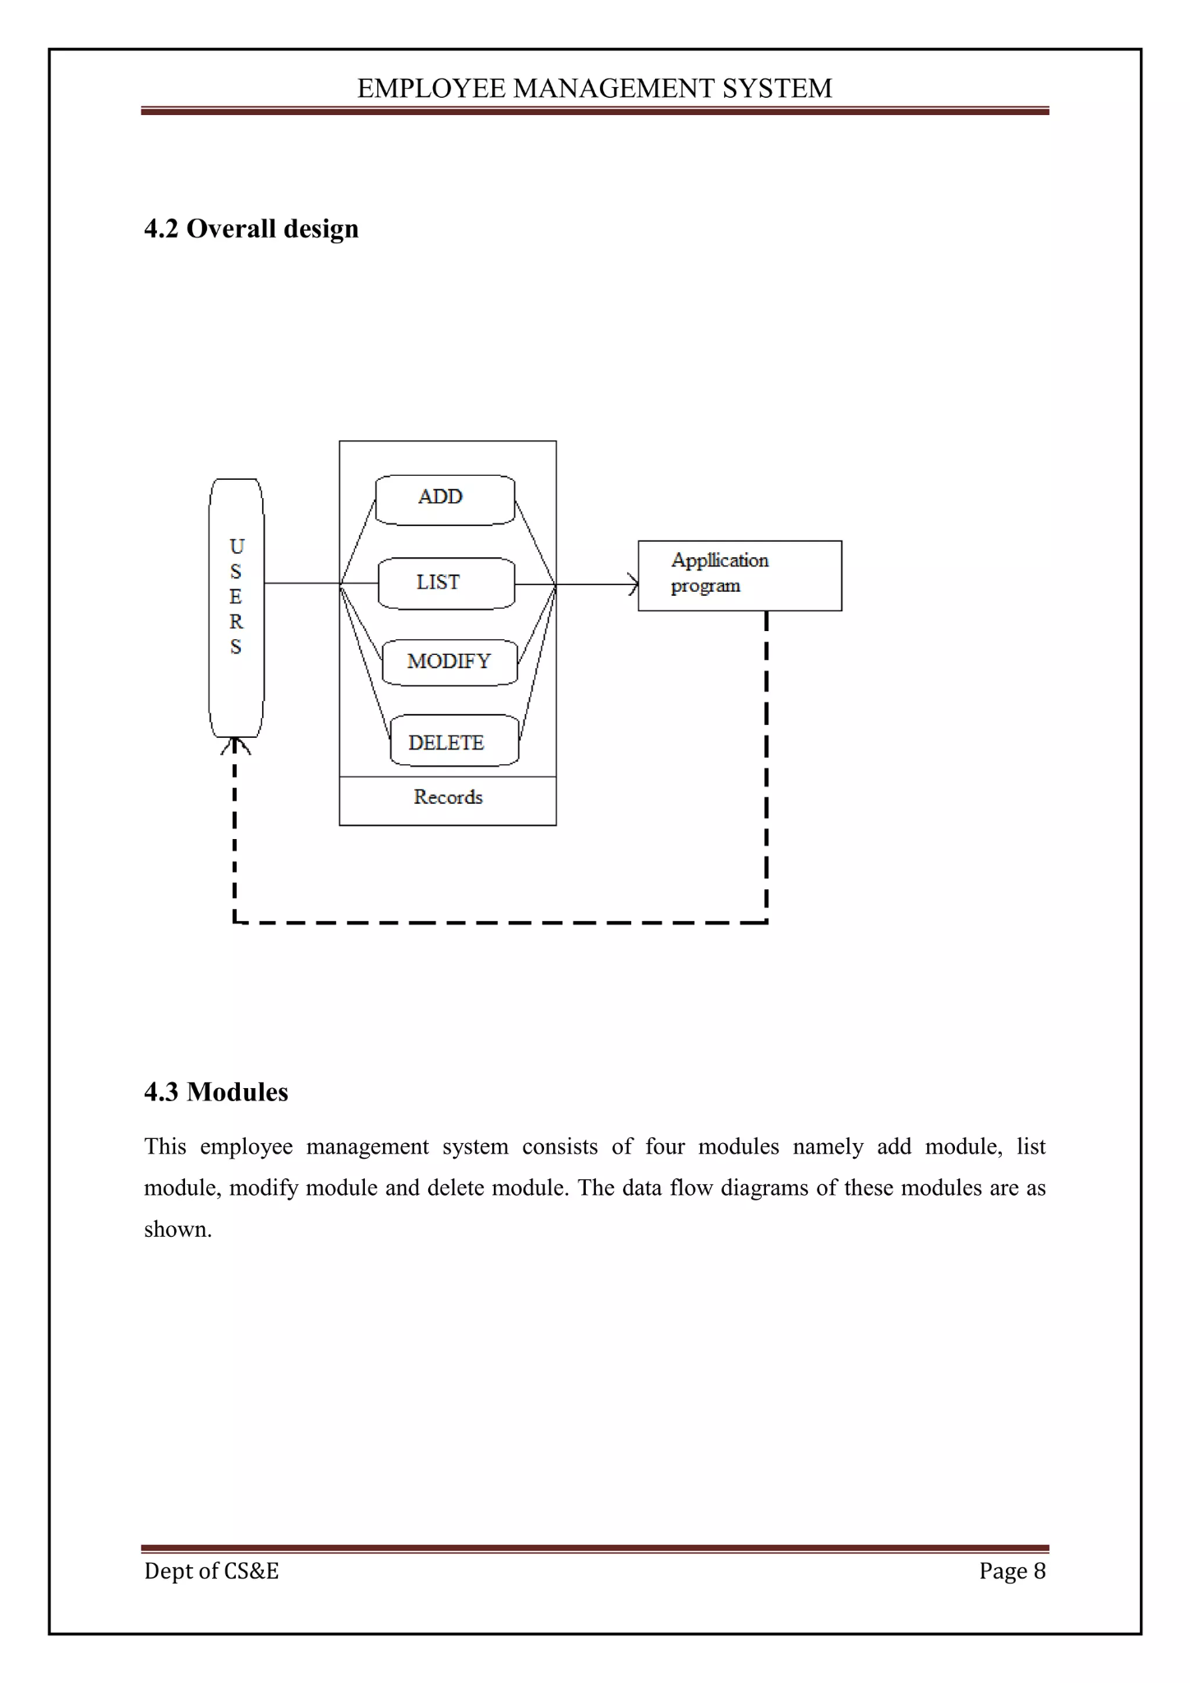
FLOW CHART:

Slide 6
Add Employee Functionality:
The 'Add Employee' functionality is a key feature of our system that allows users to easily add new employees to their organization's database. With just a few clicks, users can enter all the necessary information about a new employee, including their name, contact details, job title, and more.
One of the biggest benefits of this functionality is that it saves time and reduces errors. Instead of manually entering employee information into a spreadsheet or other system, users can simply use the 'Add Employee' functionality to quickly and accurately input all the necessary data. This not only streamlines the process but also reduces the risk of typos, missing information, and other common errors.

Slide 7
View Employee Functionality:
The 'View Employee' functionality allows users to access detailed information about each employee in the system. This includes personal details such as name, address, and ID and etc. Users can also view an employee's work history, including past positions held within the company and any promotions or awards they have received.

Slide 8
Edit Password Functionality:
The Edit Password functionality of our system allows users to change their login credentials easily and securely. When a user selects this option, they will be prompted to enter their current password followed by their desired new password. Our system ensures that the new password meets all security requirements, such as minimum length and complexity, before allowing the change to take effect.
In addition to providing a convenient way for users to update their passwords, this functionality also adds an extra layer of security to our system. By requiring users to verify their identity with their current password, we can prevent unauthorized access to sensitive information and protect against potential security.

Slide 9
Search Employee Functionality
The 'Search Employee' functionality of our system provides a quick and efficient way to find specific employee records. This feature allows users to search for employees based on various criteria such as name, department, or job title.
By using this functionality, users can save valuable time that would otherwise be spent manually sifting through employee records. Additionally, the search results are displayed in an organized and easy-to-read format, making it simple to locate the desired information.

Slide 10
Delete Employee Functionality:
The 'Delete Employee' functionality is an important feature of our system that helps keep employee records up-to-date. With this functionality, users can easily remove employees who are no longer with the company or have been transferred to a different department.
To use this functionality, simply select the employee you wish to delete and confirm the action. The system will automatically update all relevant records and ensure that the employee's information is removed from all associated files. This not only keeps your records accurate but also ensures compliance with data privacy regulations.

Slide 11
THANK YOU

